Slide 1
Probability Theory: Uncertainty Measure
Lecture Module 22

Slide 2
Uncertainty
Most intelligent systems have some degree of uncertainty associated with them.
Uncertainty may occur in KBS because of the problems with the data.
  Data might be missing or unavailable.
  Data might be present but unreliable or ambiguous due to measurement errors, multiple conflicting measurements etc.
  The representation of the data may be imprecise or inconsistent.
  Data may just be expert's best guess.
  Data may be based on defaults and the defaults may have exceptions.

Slide 3
Cont…
Given numerous sources of errors, the most KBS requires the incorporation of some form of uncertainty management.
For any form of uncertainty scheme, we must be concerned with three issues.
  How to represent uncertain data?
  How to combine two or more pieces of uncertain data?
  How to draw inference using uncertain data?
Probability is the oldest theory with strong mathematical basis.
Other methods for handling uncertainty are Bayesian belief network, Certainty factor theory etc.

Slide 4
Probability Theory
Probability is a way of turning opinion or expectation into numbers.
It lies between 0 to 1 that reflects the likelihood of an event.
The chance that a particular event will occur = the number of ways the event can occur divided by the total number of all possible events.
Example: The probability of throwing two successive heads with a fair coin is 0.25
  Total of four possible outcomes are :
HH, HT, TH & TT
  Since there is only one way of getting HH,
  probability = ¼ = 0.25

Slide 5
Event
Event: Every non-empty subset A (of sample space S) is called an event.
  null set Φ is an impossible event.
  S is a sure event
P(A) is notation for the probability of an event A.
P(Φ) = 0 and P(S) = 1
The probabilities of all events S = {A1, A2, …, An} must sum up to certainty i.e. P(A1) + … + P(An) = 1
Since the events are the set, it is clear that all set operations can be performed on the events.
If A and B are events, then
  A ∩ B ; A∪ B and A' are also events.
  A - B is an event "A but not B
  Events A and B are mutually exclusive, if A ∩ B=Φ

Slide 6
Axioms of Probability
Let S be a sample space, A and B are events.
  P(A) ≥ 0
  P(S) = 1
  P(A’ ) = 1 - P(A)
  P(A ∪ B ) = P(A) + P(B) – P(A ∩ B)
  If events A and B are mutually exclusive, then
  P(A ∪ B ) = P(A) + P(B),
In general, for mutually exclusive events A1,…,An in S
P(A1 ∪ A2 ∪… ∪ An ) = P(A1) + P(A2) + …+ P(An)

Slide 7
Joint Probability
Joint Probability of the occurrence of two independent events is written as P(A and B) and is defined by
  P(A and B) = P(A ∩ B) = P(A) * P(B)
Example: We toss two fair coins separately.
Let P(A) = 0.5 , Probability of getting Head of first coin
P(B) = 0.5, Probability of getting Head of second coin
Probability (Joint probability) of getting Heads on both the coins is
= P(A and B)
= P(A) * P(B) = 0.5 X 0.5 = 0.25
The probability of getting Heads on one or on both of the coins i.e. the union of the probabilities P(A) and P(B) is expressed as
P(A or B) = P(A ∪ B) = P(A) + P(B) - P(A) * P(B)
= 0.5 + 0.5 - 0.25
= 0.75

Slide 8
Conditional Probability
It relates the probability of one event to the occurrence of another i.e. probability of the occurrence of an event H given that an event E is known to have occurred.
Probability of an event H (Hypothesis), given the occurrence of an event E (evidence) is denoted by P(H | E) and is defined as follows:
Number of events favorable to H which are also favorable to E
P(H | E) =
No. of events favorable to E
P(H and E)
=
P(E)

Slide 9
Example
What is the probability of a person to be male if person chosen at random is 80 years old?
The following probabilities are given
  Any person chosen at random being male is about 0.50
  probability of a given person be 80 years old chosen at random is equal to 0.005
  probability that a given person chosen at random is both male and 80 years old may be =0.002
The probability that an 80 years old person chosen at random is male is calculated as follows:
P(X is male | Age of X is 80)
= [P(X is male and the age of X is 80)] / [P(Age of X is 80)]
= 0.002 / 0.005 = 0.4

Slide 10
Conditional Probability with Multiple Evidences
If there are n evidences and one hypothesis, then conditional probability is defined as follows:
P(H and E1 … and En)
P(H | E1 and … and En) =
P(E1 and … and En)

Slide 11
Bayes’ Theorem
Bayes theorem provides a mathematical model for this type of reasoning where prior beliefs are combined with evidence to get estimates of uncertainty.
This approach relies on the concept that one should incorporate the prior probability of an event into the interpretation of a situation.
It relates the conditional probabilities of events.
It allows us to express the probability P(H | E) in terms of the probabilities of P(E | H), P(H) and P(E).
P(E|H) * P(H)
P(H|E) = P(E)

Slide 12
Proof of Bayes’ Theorem
Bayes’ theorem is derived from conditional probability.
Proof: Using conditional probability
P(H|E) = P(H and E) / P(E)
⇒ P(H|E) * P(E) = P(H and E) (1)
Also P(E|H) = P(E and H) / P(H)
⇒ P(E|H) * P(H) = P(E and H) (2)
From Eqs (1) and (2), we get
P(H|E) * P(E) = P(E|H) * P(H)
Hence, we obtain
P(E|H) * P(H)
P(H|E) =
P(E)

Slide 13
Extension of Bayes’ Theorem
Consider one hypothesis H and two evidences E1 and E2.
The probability of H if both E1 and E2 are true is calculated by using the following formula:
P(E1| H) * P(E2| H) * P(H)
P(H|E1 and E2) = P(E1 and E2)

Slide 14
Contd..
Consider one hypothesis H and Multiple evidences E1,…., En.
The probability of H if E1,…, En are true is calculated by using the following formula:
P(E1| H) * … * P(En | H) * P(H)
P(H|E1 and … and En) = P(E1 and … and En)

Slide 15
Example
Find whether Bob has a cold (hypotheses) given that he sneezes (the evidence) i.e., calculate P(H | E).
Suppose that we know / given the following.
P(H) = P (Bob has a cold) = 0.2
P(E | H)= P(Bob was observed sneezing
| Bob has a cold) = 0.75
P(E | ~H)= P(Bob was observed sneezing
| Bob does not have a cold) = 0.2
Now
P(H | E) = P(Bob has a cold | Bob was observed sneezing)
= [ P(E | H) * P(H) ] / P(E)

Slide 16
Cont…
We can compute P(E) as follows:
P(E) = P( E and H) + P( E and ~H)
= P(E | H) * P(H) + P(E | ~H) * P(~H)
= (0.75)(0.2) + (0.2) (0.8) = 0.31
  Hence P(H | E) = [(0.75 * 0.2)] / 0.31 = 0.48387
  We can conclude that “Bob’s probability of having a cold given that he sneezes” is about 0.5
Further it can also determine what is his probability of having a cold if he was not sneezing?
P(H | ~E) = [P(~E | H) * P(H)] / P(~E) = [(1 – 0.75) * 0.2] / (1 – 0.31)
= 0.05 / 0.69 = 0.072
  Hence “Bob’s probability of having a cold if he was not sneezing” is 0.072

Slide 17
Advantages and Disadvantages of Bayesian Approach
Advantages:
They have sound theoretical foundation in probability theory and thus are currently the most mature of all certainty reasoning methods.
Also they have well-defined semantics for decision making.
Disadvantages:
They require a significant amount of probability data to construct a KB.
  For example, a diagnostic system having 50 detectable conclusions (R) and 300 relevant and observable characteristics (S) requires a minimum of 15,050 (R*S + R) probability values assuming that all of the conclusions are mutually exclusive.

Slide 18
Cont…
If conditional probabilities are based on
  statistical data, the sample sizes must be sufficient so that the probabilities obtained are accurate.
  human experts, then question of values being consistent & comprehensive arise.
The reduction of the associations between the hypothesis and evidence to numbers also eliminates the knowledge embedded within.
  The ability to explain its reasoning and to browse through the hierarchy of evidences to hypothesis to a user are lost.

Slide 19
Probabilities in Facts and Rules of Production System
Some Expert Systems use Bayesian theory to derive further concepts.
  We know that KB = facts + Rules
We normally assume that the facts are always completely true but facts might also be probably true.
Probability can be put as the last argument of a predicate representing fact.
Example:
a fact "battery in a randomly picked car is 4% of the time dead" in Prolog is expressed as
battery_dead (0.04).
  This fact indicates that ‘battery is dead’ is sure with probability 0.04.

Slide 20
Probability in Rules
If_then rule in rule-based Systems can incorporate probability as follows:
  if X is true then Y can be concluded with probability P
Examples:
Consider the following probable rules and their corresponding Prolog representation.
  "if 30% of the time when car does not start, it is true that the battery is dead "
battery_dead (0.3) :- ignition_not_start(1.0).
  Here 30% is rule probability. If right hand side of the rule is certain, then we can even write above rule as:
battery_dead(0.3) :- ignition_not_start.
  "the battery is dead with same probability that the voltmeter is outside the normal range"
battery_dead(P) :-voltmeter_measurment_abnormal(P).

Slide 21
Cumulative Probabilities
Combining probabilities from the facts and successful rules to get a cumulative probability of the battery being dead is an important issue.
  We should gather all relevant rules and facts about the battery is dead.
The probability of a rule to succeed depends on probabilities of sub goals on the right side of a rule.
  The cumulative probability of conclusion can be calculated by using and-combination.
In this case, probabilities of sub goals in the right side of rule are multiplied, assuming all the events are independent of each other using the formula
Prob(A and B and C and .....) = Prob(A) * Prob(B) * Prob(C) * ...

Slide 22
Cont…
The rules with same conclusion can be uncertain for different reasons.
If there are more than one rules with the same predicate name having different probabilities, then in cumulative likelihood of the above predicate can be computed by using or-combination.
To get overall probability of predicate, the following formula is used to get 'or' probability if events are mutually independent.
Prob(A or B or C or ...)
= 1 - [(1 - Prob(A)) (1 - Prob(B)) (1 - Prob(C))....]

Slide 23
Examples
1. "half of the time when a computer does not work, then the battery is dead"
battery_dead(P):-computer_dead(P1), P is P1*0.5.
  Here 0.5 is a rule probability.
2. "95% of the time when a computer has electricalproblem and battery is old, then the battery is dead"
battery_dead(P) :- electrical_prob(P1), battery_old(P2), P is P1 * P2 * 0.95.
  Here 0.95 is a rule probability.
The rule probability can be thought of hidden and is combined along with associated probabilities in the rule.

Slide 24
Prolog Programs for Cumulative Probabilities
And-combination: collect all the probabilities in a list and compute the product of these to get and-comb effect.
and_comb([P], P).
and_comb([H | T], P) :- and_comb(T, P1), P is P1 * H.
Assumption is that the sub goals in the rule are independent of each other.
Or-combination: Compute probabilities of all the rules with the same predicate name as head in a list and compute or_comb probability.
or_comb([P], P).
or_comb([H|T],P):-or_comb(T,P1),P is 1-((1-H) * (1-P1)).

Slide 25
Production System for Diagnosis of malfunctioning Equipment using Probability
Let us develop production system for diagnosis of malfunctioning of television using probabilities.
We have to identify situations when television is not working properly.
We broadly imagine one of two things may be improperly adjusted.
  the controls (knobs and switches)
  the receiver (antenna or cable)

Slide 26
Contd…
Knobs adjustment
Knobs might be adjusted wrong on television because of the following reasons (by no mean exhaustive)
  If television is old and require frequent adjustment.
  Unusual usage (i.e., any thing strange has happened lately that required adjustment of the knobs).
  If children use your set and they play with the knobs.

Slide 27
Diagnosis of Malfunctioning Equipment using Probability
Let us develop rule based system for diagnosis of malfunctioning of landline telephone using probabilities.
Identify situations when telephone is not working properly.
Broadly imagine one of the following things may be the reasons
  Faulty Instrument
  Problem with exchange
  Broken cable
Must note that these rules are to be carefully designed in consultation with domain expert.

Slide 28
Few Rules from expert for Instrument
Rule1: If instrument is old and has been repaired in the past many times then it is 40% sure that fault lies with the instrument.
telephone_not_working(0.4) :- ask(tele_history).
Rule2: If instrument is fallen on the ground and broke then it is 80% sure that fault lies with the instrument.
telephone_not_working(0.8) :- ask(tele_broken).

Slide 29
Rules – Cont…
Rule3: If children are present and use your set and play with the key pad with some probability, then it is 80% sure that the instrument is faulty because of unusual usage.
telephone_not_working(P) :- ask(children_present, P1), ask(children_keypad, P2),
and_comb([P1, P2, 0.8], P).
This rule says that when both the conditions hold (children are present and children play with key pads) with some probabilities, then it means, "it is 80% sure that the instrument is faulty ".

Slide 30
Cont…
Finally get the cumulative probability for telephone not working because of the instrument fault.
We need to combine probabilities of all the rules using or-combination.
The corresponding rule is:
instrument_faulty(P) :- findall(X, telephone_not_working(X), L), or_comb(L, P).
The final rule for diagnosis for instrument faulty is assumed to be 70% sure might be written as follows:
diagnosis('Instrument is faulty', P) :- instrument_faulty(P1), and_comb([P1, 0.7], P).

Slide 31
Rules – Cont…
Let us consider other kinds of telephone diagnosis such as exchange, cable connection etc.
exchange_probability(0.99) :- ask(exchange_problem).
exchange_probability (0.5) :- ask(connecting_switch_problem).
overall_exchage_probability(P):-
findall(X, exchange_probabilty(X), L),
or_combination(L, P).
cable_broken_probabilty (0.98):-
ask(cable_old), ask(if_storm_recently).
cable_broken_probability (0.3):- ask(recent_furniture_rearranging).
overall_cable_probabilty(P):-
findall(X, cable_broken_probability(X), L),
or_combination(L, P).

Slide 32
Rules for Diagnosis
Rule1: Cable faulty is 80% sure :
diagnosis( 'Cable_problem', P):- overall_cable_probabilty(P1),
and_comb([P1, 0.8], P).
Rule2: Exchange problem is 90% sure:
diagnosis( 'Exchange_problem', P):- overall_exchange_probabilty(P1),
and_comb([P1, 0.9], P).
To run such a system, invoke a Goal as:
?- diagnosis(D, P).

Slide 33
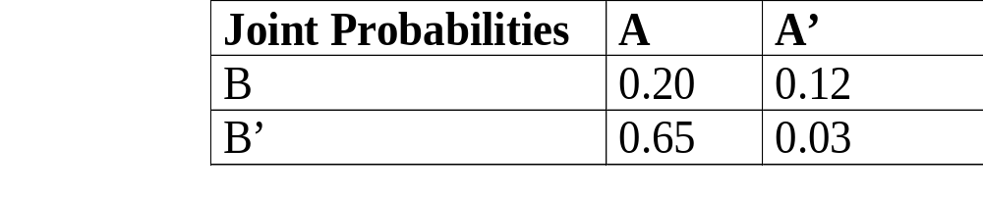
Bayesian Belief Network
Joint probability distribution of two variables A and B are given in the following Table.
The joint distribution basically is to look for a relationship between two variables.
Joint probability distribution for n variables require 2^{n} entries with all possible combinations.
The time and storage requirements for such computations become impractical as n grows.

Slide 34
Contd..
Inferring with such large numbers of probabilities does not seem to model human process of reasoning.
Human tends to single out few propositions which are known to be causally linked when reasoning with uncertain beliefs.
This leads to the concept of forming belief network called a Bayesian belief network.
It is a probabilistic graphical model that encodes probabilistic relationships among set of variables with their probabilistic dependencies.
This belief network is an efficient structure for storing joint probability distribution.

Slide 35
Definition of BBN
It is a acyclic (with no cycles) directed graph where the nodes of the graph represent evidence or hypotheses and arc connecting two nodes represents dependence between them.
If there is an arc from node X to another node Y (i.e., X →Y), then X is called a parent of Y, and Y is a child of X.
The set of parent nodes of a node X_{i} is represented by parent_nodes(X_{i}).

Slide 36
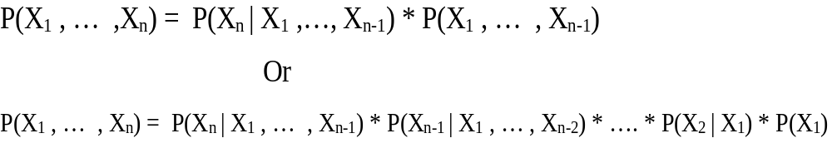
Joint Probability of n variables
Joint probability for ‘n’ variables (dependent or independent) is computed as follows.
For the sake of simplicity we write P(X₁ , … , X_{n}) instead of P(X₁ and … and X_{n}).

Slide 37

Joint Probability of ‘n’ Variables using B-Network
In Bayesian Network, the joint probability distribution can be written as the product of the local distributions of each node and its parents such as:
This expression is reduction of joint probability formula of ‘n’ variables as some of the terms corresponding to independent variables will not be required.

Slide 38
Cont…
If node Xi has no parents, its probability distribution is said to be unconditional and it is written as P(Xi) instead of P(Xi | parent_nodes(Xi)).
Nodes having parents are called conditional.
If the value of a node is observed, then the node is said to be an evidence node.
Nodes with no children are termed as hypotheses node and nodes with no parents are called independent nodes.

Slide 39
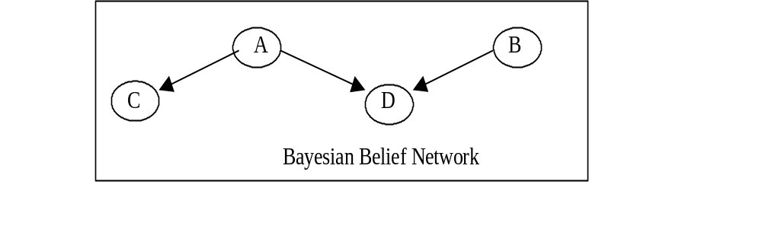
Example
The following graph is a Bayesian belief network.
  Here there are four nodes with {A, B} representing evidences and {C, D} representing hypotheses.
  A and B are unconditional nodes and C and D are conditional nodes.

Slide 40
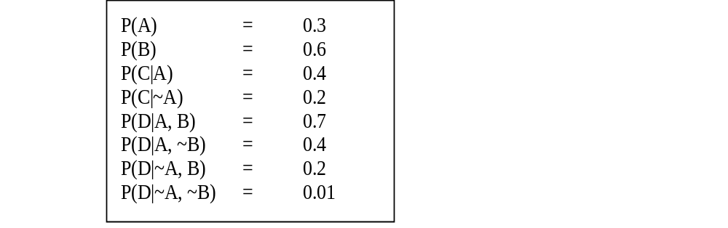
Cont...
To describe above Bayesian network, we should specify the following probabilities.

Slide 41
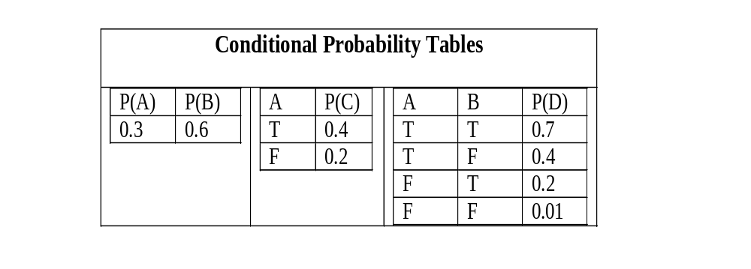
Cont…
They can also be expressed as conditional probability tables as follows:

Slide 42
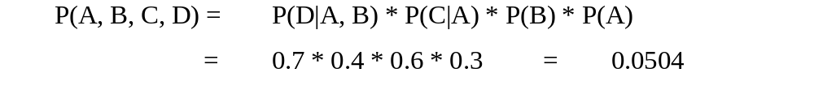
Cont…
Using Bayesian belief network on previous slide, only 8 probability values in contrast to 16 values are required in general for 4 variables {A, B, C, D} in joint distribution probability.
Joint probability using Bayesian Belief Network is computed as follows:

Slide 43
Example of Simple B-Network
Suppose that there are three events namely earthquake, burglary or tornado which could cause ringing of alarm in a house.
This situation can be modeled with Bayesian network as follows.
All four variables have two possible values T (for true) and F (for false).
  Here the names of the variables have been abbreviated to A = Alarm, E = Earthquake, and B = Burglary and T = Tornado.

Slide 44
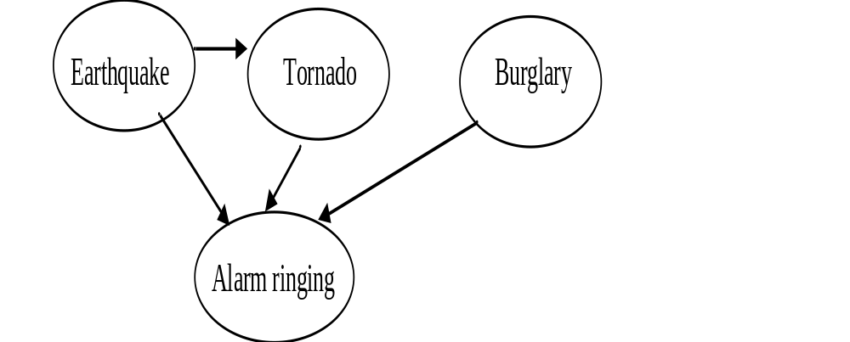
Cont…

Slide 45
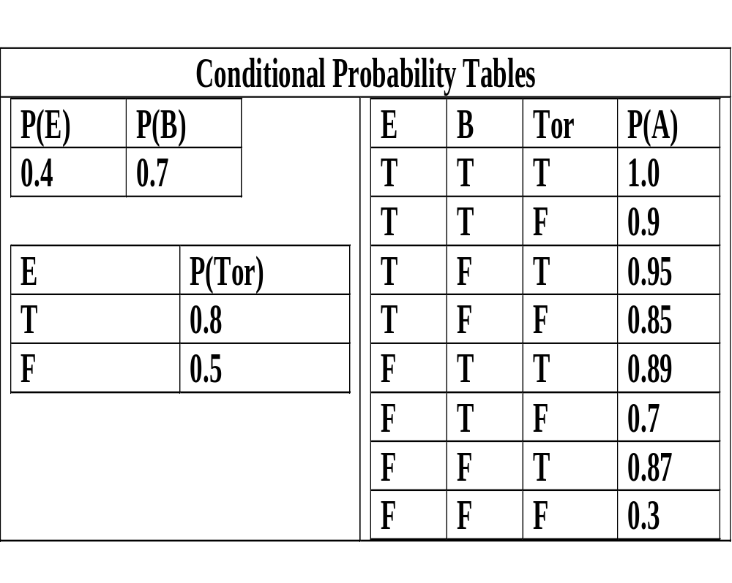
Cont…
Table contains the probability values representing complete Bayesian belief network.
Prior probability of ‘earthquake’ is 0.4 and if it is earthquake then probability of ‘tornado’ is 0.8. and if not then the probability of ‘earthquake’ is 0.5.

Slide 46
Cont…
The joint probability is computed as follows:
P(E, B, T, A) = P(A| E, B, T) * P(T|E) * P(E) * P(B)
= 1.0 * 0.8 * 0.4 * 0.7 = 0.214
Using this model one can answer questions using the conditional probability formula as follows:
  "What is the probability that it is earthquake, given the alarm is ringing?" P(E|A)
  "What is the probability of burglary, given the alarm is ringing?" P(B|A)
  "What is the probability of ringing alarm if both earthquake and burglary happens?" P(A|E, B)

Slide 47
Advantages of Bayesian B Network
It can easily handle situations where some data entries are missing as this model encodes dependencies among all variables.
It is intuitively easier for a human to understand direct dependencies than complete joint distribution.
It can be used to learn causal relationships.
It is an ideal representation for combining prior knowledge (which often comes in causal form) and data because the model has both causal and probabilistic semantics.

Slide 48
Disadvantages of BB Network
The probabilities are described as a single numeric point value. This can be a distortion of the precision that is actually available for supporting evidence.
There is no way to differentiate between ignorance and uncertainty. These are distinct two different concepts and be treated as such.
The quality and extent of the prior beliefs used in Bayesian inference processing are major shortcomings.
Reliability of Bayesian network depends on the reliability of prior knowledge.
Selecting the proper distribution model to describe the data has a notable effect on the quality of the resulting network. Therefore, selection of the statistical distribution for modeling the data is very important.

Slide 49
Certainty Factor Theory
Certainty factor theory provides another way of measuring uncertainty by describing a practical way of compromising on pure Bayesian system.
Certainty factor is based on a number of observations.
In traditional probability theory, the sum of confidence for a relationship and against a relationship must add up to 1.
In practical situation, an expert might have some confidence about some relationship being true and have no idea about the relationship being untrue.
Confidence measures correspond to the informal evaluations that human experts attach to their conclusions, such as 'it is probably or likely true‘.

Slide 50
Contd…
The certainty factor is based on 'confidence for' and 'confidence against'
The MB[H, E] is a measure of belief in the range [0, 1] in hypothesis H given the evidence E.
  If evidence supports it fully then MB[H, E] = 1 and it is zero if the evidence fails to support the hypothesis.
Similarly, MD[H, E] is a measure of disbelief in the range [0, 1] in hypothesis H given the evidence E.
  It measures the extent to which the evidence E supports the negation of the hypothesis H.
It is to be noted that MD is not compliment of MB.

Slide 51
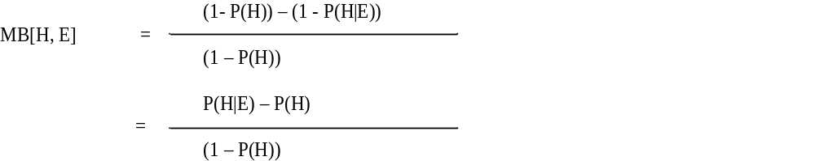
Measure of belief
The measure of belief calculates the relative decrement of disbelief in a given hypothesis H due to some evidence E.
It may be intuitively defined as follows:

Slide 52
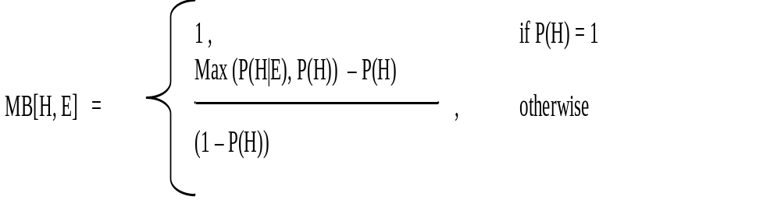
Cont…
In order to avoid getting a negative value of belief, we can modify the above definition to obtain positive value of measure as follows:

Slide 53
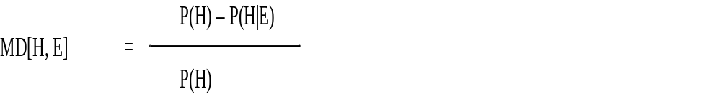
Measure of disbelief
The measure of disbelief (MD) is similarly defined as the relative decrement of belief in a given hypothesis H due to some evidence E. It may be represented as follows:
It may be intuitively defined as follows:

Slide 54
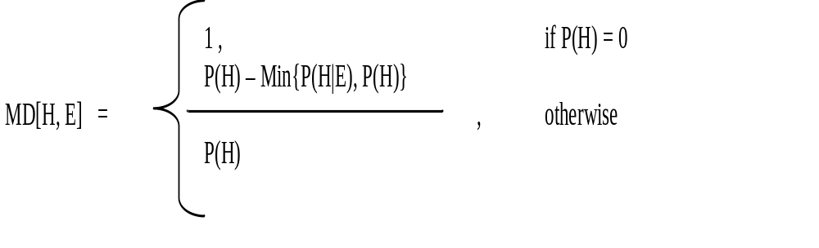
Cont…
Alternatively,

Slide 55
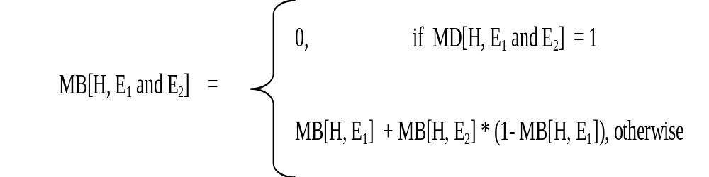
Two Evidences supporting hypothesis
Case1: Incrementally acquired evidence
Compute CF(H, E1 and E2).
Let us first compute MB(H, E1 and E2) and MD(H, E1 and E2)
Similarly MD is defined

Slide 56
Example
Suppose we make an initial observation E1 that confirms our belief in H with MB[H, E1) = 0.4 and MD(H, E1) = 0. Consider second observation E2 that also confirms H with MB[H, E2) = 0.3. Then CF(H, E1) = 0.4
MB(H, E1 and E2) = MB(H, E1) + MB(H, E2) * (1 – MB(H, E1))
= 0.4 + 0.3 * (1-MB(H, E1))
= 0.4 +0.18 = 0.58
and
MD(H, E1 and E2) = 0.0
Therefore,
CF(H, E1 and E2) = 0.58
Here we notice that slight confirmatory evidence can larger certainty factor.

